Slide 1
Smart key locker
propusa de : Andreea-Larisa Avadanei (Sfirnaciuc)
Coordonator Stiintific: Lect. Dr. Anca Ignat

Slide 2
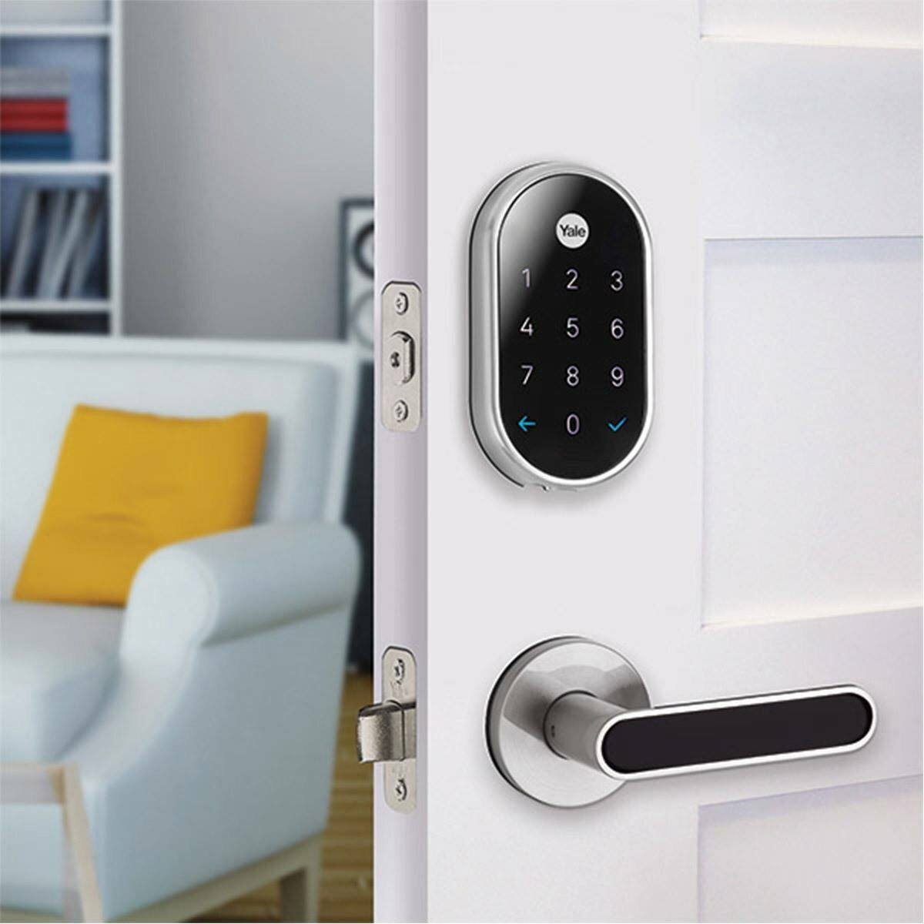
Motivation

Slide 3
Contribution + what others DID
Combine the code pin with the email as a 2 step verification
Writing my own code from 0
The logic implementation
learning
Other key lockers use all kinds of identification as a single step verification(ex : finger print, pin code, card, phone)

Slide 4
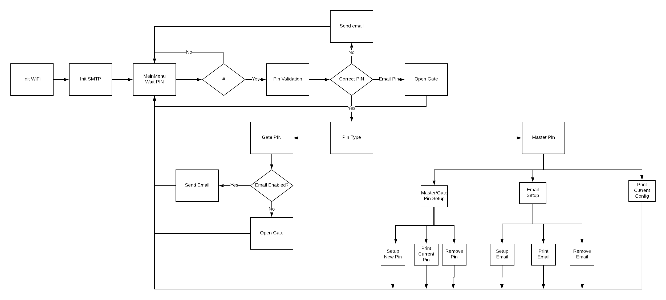
Application structure

Slide 5
How it works?
In order to offer a short overview of my project I will explain from two point of view the project idea.
A black box overview. What user is seeing and what operation should make with the locker.
A white box overview. This is regarding what is inside the code, what each class stands for.

Slide 6
DEMO

Slide 7
DEMO

Slide 8
Problems encountered
An issue which I had it was regarding how I can send an email and how can I connect to the WiFi. These two issues I solved them by using the libraries "WiFiClientSecure.h" and "ESP8266WiFi". Also here I had the issue that an insecure email could not be sent because of google restrictions. In order to solve this issue I had to go in emails setting and enable Less secure app access
Another issue was how can I make the communication between the moteino and WiFi nodes. This I got solved through making the Moteino WiFi send and wait responses from each other.

Slide 9
Conclusion and directions for future development
While working on this project I got to discover how fun and hard at the same time is it to start a project from the beginning without having loads of knowledge in the beginning.
Through this project I have educated my style of working and also I have improved my abilities to solve my own blocking points.

Slide 10
Conclusion and directions for future development
What I would like to improve:
An improvement which I find it absolutely necessary is the security of the password. In order to make the security more stronger I will add a cyclic redundancy check function.
Another improvement would be for the situations were the WiFi module has an error due to any reason, the email option should be sent disabled by default.
What I would like to add:
To add manually at which address I would like to send the PIN for the 2 step verification. At the moment the email address and password are hard-coded. This would be useful when is it needed to be used this smart key lock by the multiple family members.
To add a reset function to the WiFi module.

